Slide 1
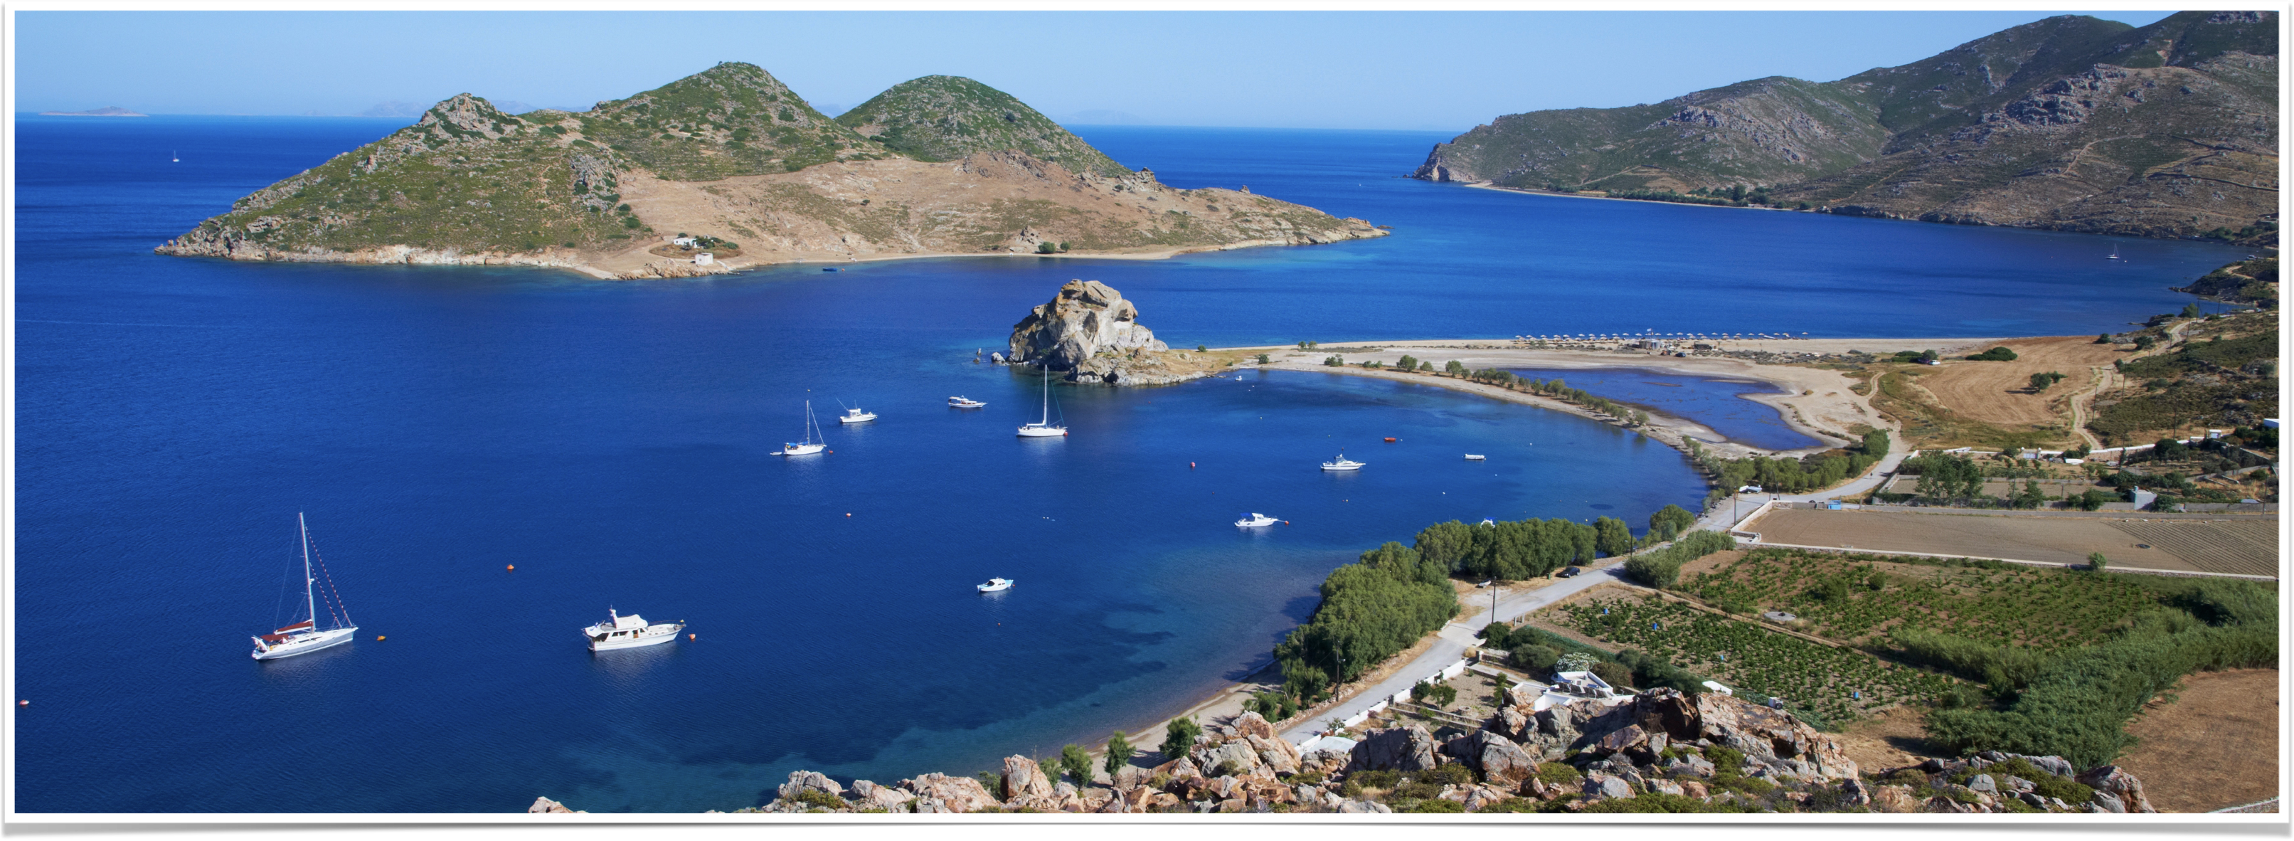
The Revelation of Jesus Christ
Vision 2 , Part 4 (8:1-12) - Seal 7, Trumpets 1-4

Slide 2
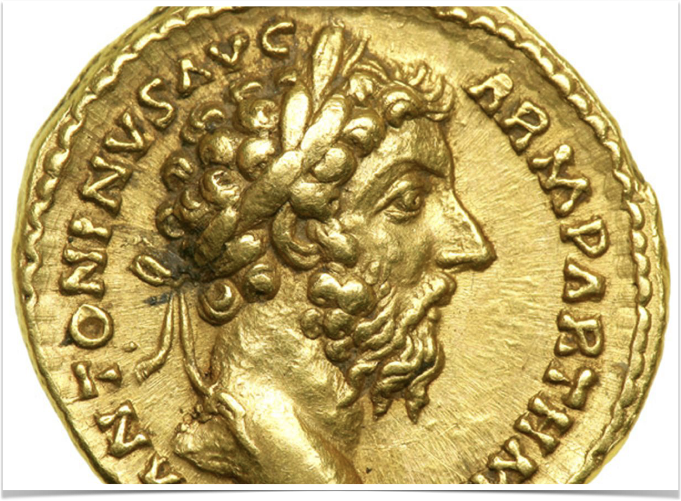
Seals 5-6 Review
Seal #5 - The persecution of the church under Diocletian
Seal #6
  Christianity replaces paganism as the state religion
  Preparation for the time of persecution ahead
Notes:
(Note: Coin from Marcus Aurelius — notice the victor crown)
Seal #5 - The persecution of the church under Diocletian
Seal #6
Christianity replaces paganism as the state religion
Preparation for the time of persecution ahead

Slide 3
“Jesus answered [Pilate], ‘My kingdom is not of this world. If My kingdom were of this world, My servants would fight, so that I should not be delivered to the Jews; but now My kingdom is not from here.’”
– John 18:36

Slide 4
“Let no one deceive you by any means; for that Day will not come unless the falling away comes first, and the man of sin is revealed, the son of perdition…And now you know what is restraining, that he may be revealed in his own time. For the mystery of lawlessness is already at work; only He who now restrains will do so until He is taken out of the way.”
–2 Thessalonians 2:3, 6-7

Slide 5


5
6
7
96 A.D.
144,000 Sealed
Belong to God
Keep themselves from idolatry
The remnant who keep the faith during the apostasy
51-52 A.D.
“…the falling away comes first”
“…the mystery of lawlessness is already at work…”

Slide 6
Seal #7 — an interlude between the seals and the trumpets
Notes:
Revelation 8:1-5, “When He opened the seventh seal, there was silence in heaven for about half an hour. [2] And I saw the seven angels who stand before God, and to them were given seven trumpets. [3] Then another angel, having a golden censer, came and stood at the altar. He was given much incense, that he should offer it with the prayers of all the saints upon the golden altar which was before the throne. [4] And the smoke of the incense, with the prayers of the saints, ascended before God from the angel's hand. [5] Then the angel took the censer, filled it with fire from the altar, and threw it to the earth. And there were noises, thunderings, lightnings, and an earthquake.”

Slide 7
Seal #7 — What John Sees
“silence” - the calm before the storm
“half an hour” - represents a very short period of time
“seven angels” - seven is the number of maturity, completion, perfection
“trumpets” - symbols of warfare, used in communication during warfare
“the angel took the censer, filled it with fire from the altar, and threw it to the earth” - Day of Atonement, Ezekiel 10:1-2, Revelation 6:10-11
Notes:
“silence” - the calm before the storm
“half an hour” - represents a very short period of time
“seven angels” - seven is the number of maturity, completion, perfection
“trumpets” - symbols of warfare, used in communication during warfare
“the angel took the censer, filled it with fire from the altar, and threw it to the earth”
Imagery reminiscent of the Day of Atonement.
Parallel to Ezekiel 10:1-2, “And I looked, and there in the firmament that was above the head of the cherubim, there appeared something like a sapphire stone, having the appearance of the likeness of a throne. [2] Then He spoke to the man clothed with linen, and said, "Go in among the wheels, under the cherub, fill your hands with coals of fire from among the cherubim, and scatter them over the city." And he went in as I watched.”
The prayers of the saints are recorded in 6:10-11, “And they cried with a loud voice, saying, "How long, O Lord, holy and true, until You judge and avenge our blood on those who dwell on the earth?" [11] Then a white robe was given to each of them; and it was said to them that they should rest a little while longer, until both the number of their fellow servants and their brethren, who would be killed as they were, was completed.

Slide 8
Seal 7 and the trumpets
Short time between Seal #6 and Trumpet #1
  325-396: seventy years from Council of Nicaea to Goth invasion of Greece
Six trumpets call invaders to gradually destroy the Roman Empire
Trumpet 7 represents the judgment day — signals the end of God’s judgment against Rome
Notes:
A short period of time elapses between the sixth seal and the first trumpet
325 – the Council of Nicea, which marks the death of the pagan Roman Empire and the birth of Christianized Rome
395 -- Division of the Empire into Western and Eastern
396 – Alaric leading a force of Goths invades Greece; eventually sacks Rome in 410 (trumpet #1)
Roughly 70 years between seals 6 and 7 and trumpet 1
Six trumpets call invaders to destroy Rome
The first four trumpets call different groups of people to invade and conquer the Western Roman Empire
Trumpets 5 and 6 call others to invade and conquer the Eastern Roman Empire.
The seventh trumpet is a proleptic vision of the Day of Judgment, signaling the end of the second vision.
While Rome had unwittingly played a hand in facilitating the church's establishment, her persecution of the church could not be ignored nor overlooked.

Slide 9
The “barbarian” invasions
Trumpets 1-4

Slide 11
Trumpet #1 — The Goths sack Rome
Notes:
Revelation 8:7, “The first angel sounded: And hail and fire followed, mingled with blood, and they were thrown to the earth. And a third of the trees were burned up, and all green grass was burned up.”

Slide 12
Trumpet #1 - What John Sees
“hail” - ravages and destruction
“fire” - fierce destruction
“mingled with blood” - carnage, war
“third of the earth” - one-third of the Roman Empire
Notes:
“hail” - ravages and destruction
“fire” - fierce destruction
“mingled with blood” - carnage, war
“third of the earth” - one-third of the Roman Empire

Slide 13
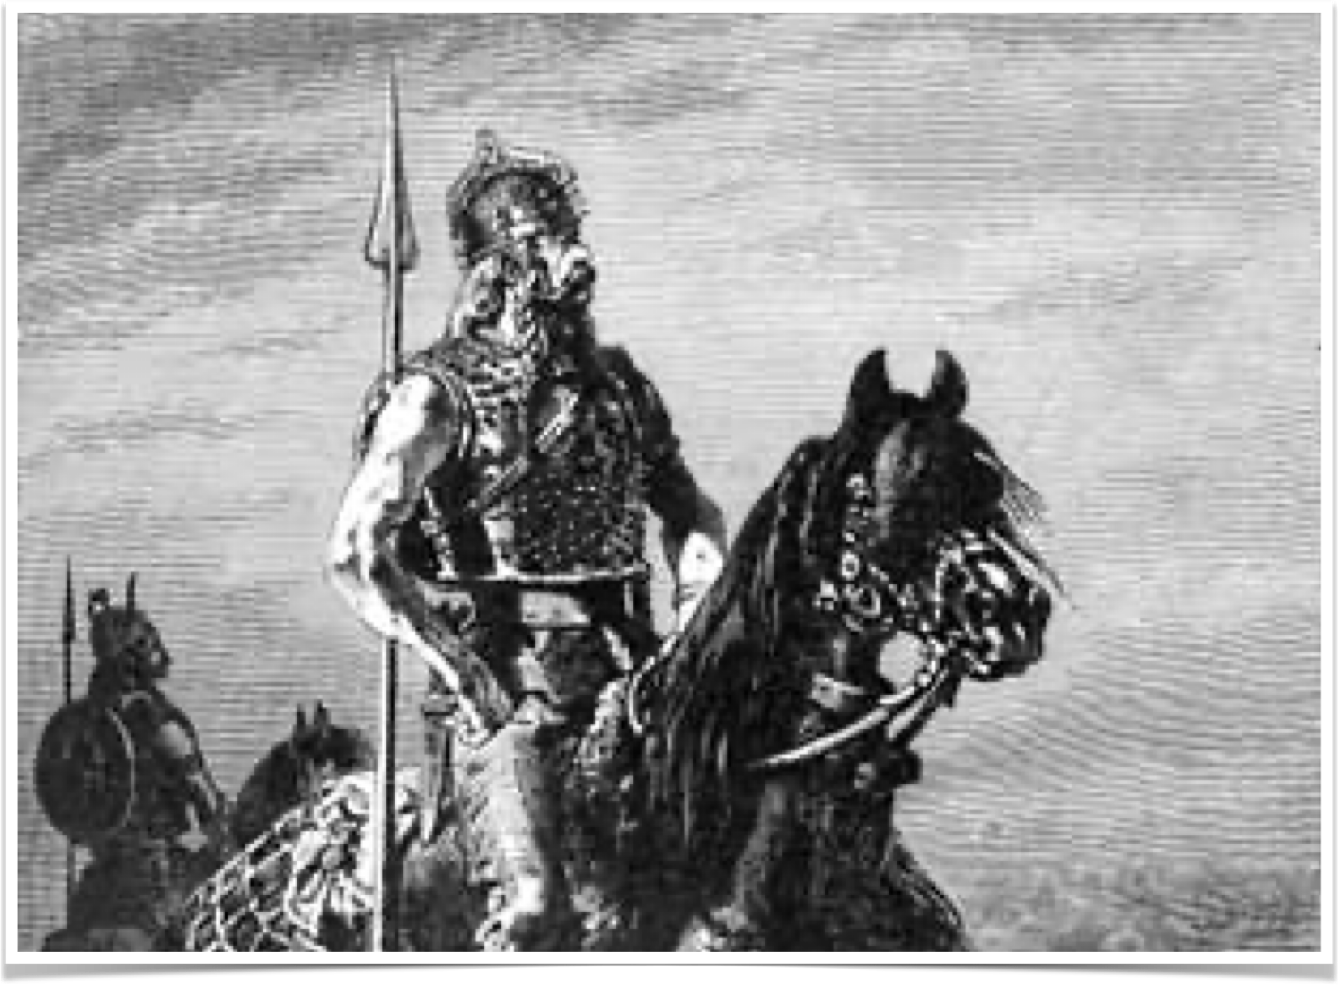
The goths sack Rome
Goths pushed westward by the advance of the Huns
Alaric
  Laid siege to Rome in 408
  Sacks Rome in 410 AD — first time Rome sacked since 390
Used “scorched earth” policy
Cannibalism used during siege
Notes:
The Goths had been pushed westward by the migration of the Huns.
The Visigoths, thoroughly beaten by the advancing Huns, begged the Roman authority to live in the Balkan area south of the Danube.
In exchange, they were forced to lay down their arms, give their children up for slavery, purchase food at incredibly inflated prices, etc.
Inflamed by their ill-treatment, the Goths revolted, burning and pillaging all of Thrace while whipping the Roman army with their cavalry.
Ravaged the area from the Balkans to Italy.
Theodosius I, emperor of the East, persuaded the Goths to fight for his army; his successor, Stilicho did not uphold this alliance.
The East's lack of loyalty led to future confrontations.
Alaric – leader of the Goths
396 - Led a host of Goths from Thrace through Greece, conquering, massacring, pillaging as he went.
401 - Invaded Italy but beaten at Polentia in 402
408 - Laid siege to Rome the first time
410 - The sack of Rome
Rome was last sacked in 390 B.C. by the Gauls – we have lost all historical records of Rome prior to this point.
The Goths used a scorched earth policy as they crossed the Roman countryside – “hail and fire followed…a third of the trees were burned up, and all green grass was burned up.”
Cannibalism was often used for sustenance during the sieges – “hail and fire…mingled with blood.”
When laying siege to Rome in 408, “Alaric [cut] off every avenue by which food could enter the capital. Soon the populace began to starve; men killed men, and women their children, to eat them. A delegation was sent to Alaric, asking terms. They warned him that a million Romans were ready to resist; he laughed, and answered, "The thicker the hay, the more easily it is mowed." Relenting, he consented to withdraw on receiving all the gold and silver and valuable movable property in the city. ‘What will then be left to us?’ the envoys asked. ‘Your lives,’ was the scornful reply. Rome chose further resistance, but starvation compelled a new offer of surrender. Alaric accepted 5000 pounds of gold, 30,000 pounds of silver, 4000 silk tunics, 3000 skins, 3000 pounds of pepper” (Durant, Age of Faith, p. 36).
In 410, Alaric felt that Rome had violated the truce and laid siege to the city again. “A slave opened the gates; the Goths poured in, and for the first time in 800 years the great city was taken by an enemy (410). For three days Rome was subjected to a discriminate pillage that left the churches of St. Peter and St. Paul untouched, and spared the refugees who sought sanctuary in them. But the Huns and slaves in the army of 40,000 men could not be controlled. Hundreds of rich men were slaughtered, their women were raped and killed; it was found almost impossible to bury all the corpses that littered the streets. Thousands of prisoners were taken, among them Honorius' half sister Galla Placidia. Gold and silver were ·seized wherever found; works of art were melted down for the precious metals they contained; and many masterpieces of sculpture and pottery were joyously destroyed by former slaves who could not forgive the poverty and toil that had generated this beauty and wealth” (Durant, Age of Faith, p. 36).

Slide 14
Summary of trumpet #1
Begins God’s answer to the martyrs’ prayer, “How long, O Lord?”
Goths invade Italy, lay siege to Rome, used scorched earth
The first time in 800 years Rome is sacked
Notes:
Begins God’s answer to the martyrs’ prayer, “How long, O Lord?”
Goths invade Italy, lay siege to Rome, used scorched earth
The first time in 800 years Rome is sacked

Slide 15
Trumpet #2 — The Vandals sack rome
Notes:
Revelation 8:8-9 Then the second angel sounded: And something like a great mountain burning with fire was thrown into the sea, and a third of the sea became blood. [9] And a third of the living creatures in the sea died, and a third of the ships were destroyed.

Slide 16
Trumpet #2 - What John sees
“mountain” - a nation (see Jer. 51:24-25)
“sea” - points to naval combat and maritime-minded people
“one third” - one-third of the Roman Empire
Notes:
“mountain” - a nation (see Jer. 51:24-25)
“sea” - points to naval combat and maritime-minded people
“one third” - one-third of the Roman Empire

Slide 17
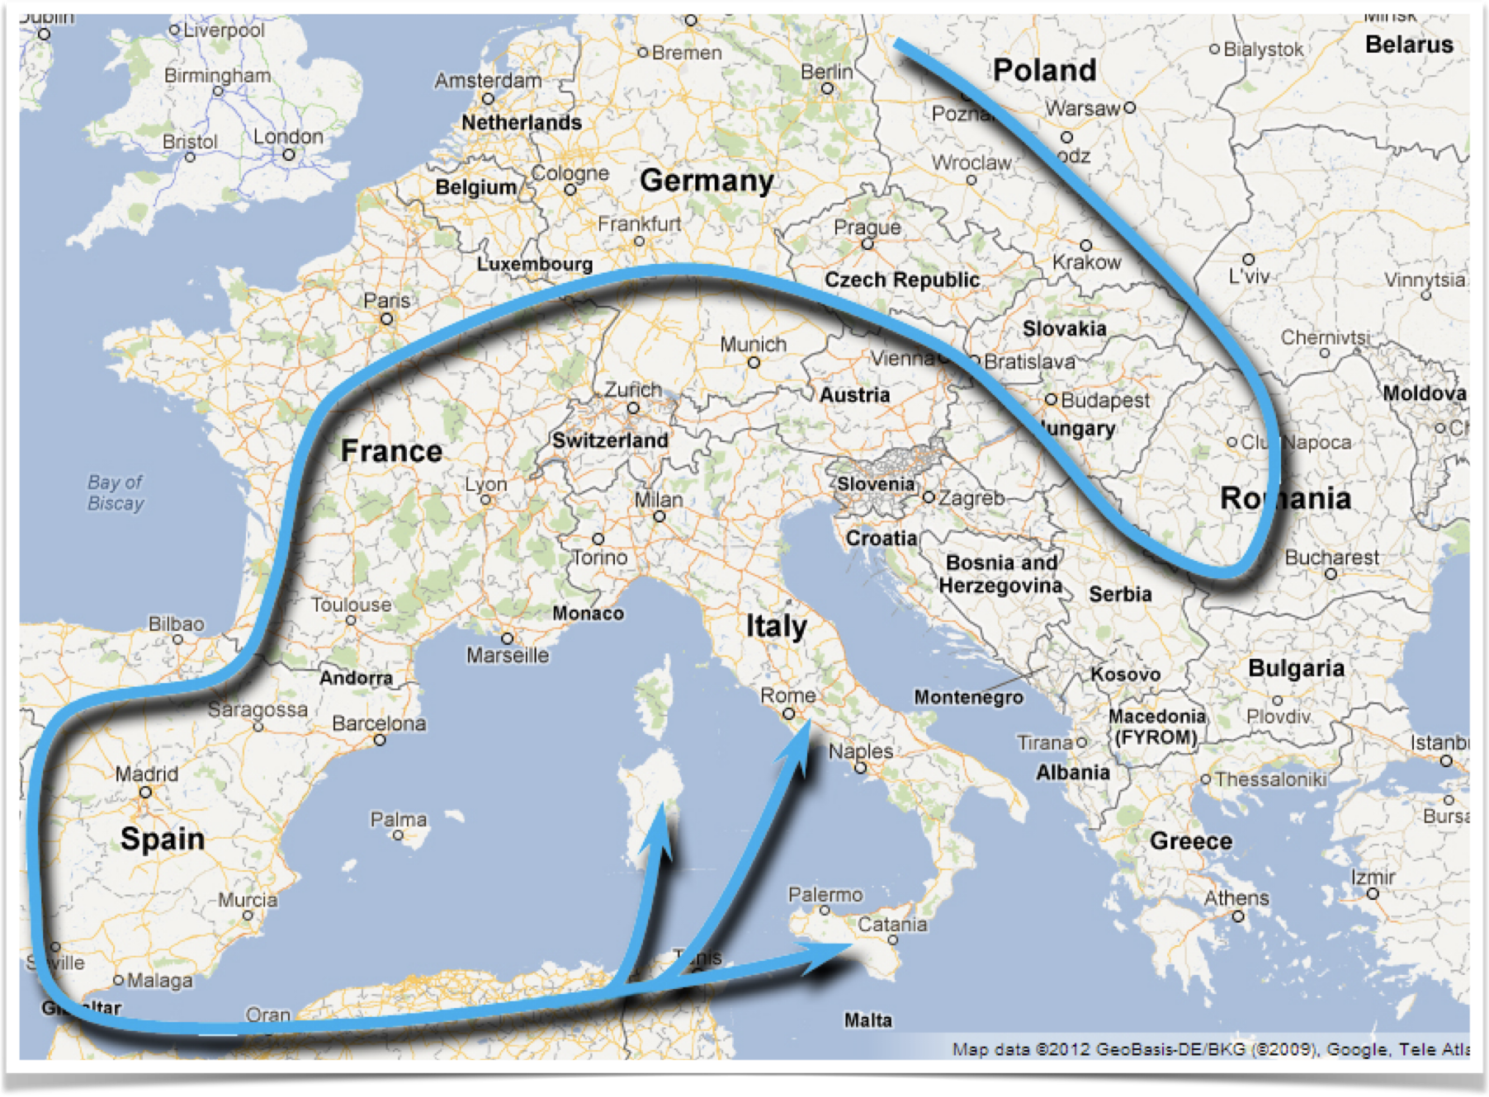
The vandals sack rome
409 - invaded Spain with 100,000 troops
429 - crossed into North Africa
435 - Rome recognizes Vandal supremacy in Africa
455 - invaded Rome from the sea
Notes:
Vandals
Originally occupied central eastern Prussia, migrated south to Hungary
Our word vandalism comes from this nation of people – inspired by their treatment of Rome
409 - Entered Spain 100,000 strong
429 - Crossed from Spain to Africa
435 - Rome recognizes Vandals' conquest of Africa
439 - Conquered Carthage without a fight and established a short-lived but dominant naval presence
455 - Invaded Rome with their invincible armada
Pope Leo negotiated a pledge against the massacre, torture, and fire.
The Vandals stripped metal off of the capital building.
Jewish temple ornaments were stolen from the Roman temple of peace.
The Vandals tore apart the city of Rome and transported the valuables to Carthage.
Rome used to dominate the sea – the Vandals destroyed this domination.

Slide 18
Summary of Trumpet #2
Vandals ended Rome’s dominance of the sea
“Gaiseric was still young. Though a capable administrator who reorganized Africa into a lucrative state, he was happiest when engaged in war. Building a great fleet, he ravaged with it the coasts of Spain, Italy, and Greece. No one could tell where his cavalry-laden ships would land next; never in Roman history had such unhindered piracy prevailed in the western Mediterranean” (Durant, The Age of Faith, p. 38).
Notes:
Vandals ended Rome’s dominance of the sea
“Gaiseric was still young. Though a capable administrator who reorganized Africa into a lucrative state, he was happiest when engaged in war. Building a great fleet, he ravaged with it the coasts of Spain, Italy, and Greece. No one could tell where his cavalry-laden ships would land next; never in Roman history had such unhindered piracy prevailed in the western Mediterranean” (Durant, The Age of Faith, p. 38).

Slide 19
Trumpet #3 - The huns invade
Notes:
Revelation 8:10-11 Then the third angel sounded: And a great star fell from heaven, burning like a torch, and it fell on a third of the rivers and on the springs of water. [11] The name of the star is Wormwood. A third of the waters became wormwood, and many men died from the water, because it was made bitter.

Slide 20
Trumpet #3 - What John Sees
“star” - symbolic of an important man
“Wormwood” - literally “bitterness”
“rivers….springs of water” – point to the use of rivers by this conqueror
Notes:
“star” - symbolic of an important man
“Wormwood” - literally “bitterness”
“rivers….springs of water” – point to the use of rivers by this conqueror

Slide 21
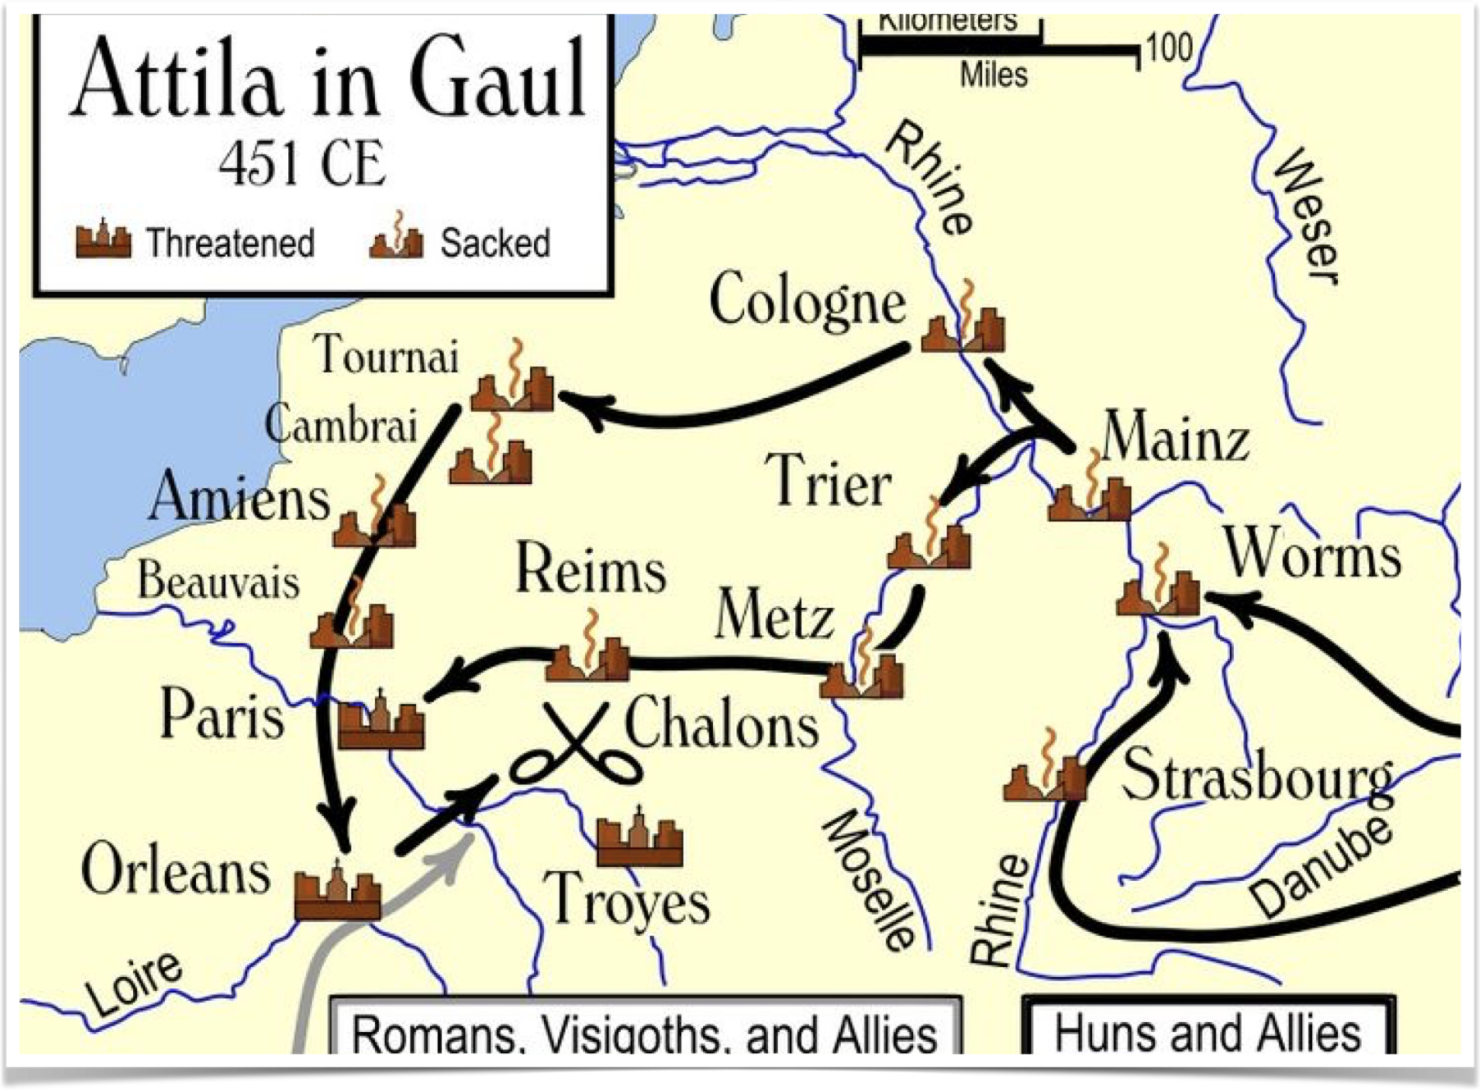
Attila the Hun
The “Scourge of God”
Many battles fought beside rivers
452 - Invades Italy; Pope Leo negotiates on behalf of the city of Rome
Attila buried by his men in the Danube
Notes:
Attila the Hun: Known as the “Scourge of God,” viewed as a punisher by both Christians and pagans.
Able to place 500,000 in the field of battle
Both Valentinian in the West and Theodosius II in the East paid him tribute for peace.
444 - Becomes the most powerful man in Europe
450 - Moves his army from the east into Gaul
451 - Crosses the Rhine River
Rivers played a major role in Attila’s campaigns.
Conquered the part of Central Europe that is geographically dominated by rivers.
Fought battles beside the Danube, Rhine, Marne, and Po - “a third of the waters became wormwood, and many men died from the water, because it was made bitter.”
452 - Invades Italy
Persuaded to leave Rome alone by Pope Leo and two Roman senators
He and his army retreat over the Alps.
His men buried him in the Danube River – “(Wormwood) fell on a third of the rivers and on the springs of water”

Slide 22
Summary of Trumpet #3
Attila and the Huns conquered the region of Central Europe that is geographically dominated by rivers.
Attila was the driving force behind the Huns' success.
The Huns' victories over Rome began and ended with Attila – once he died, their campaigns were concluded.
Notes:
Attila and the Huns conquered the region of Central Europe that is geographically dominated by rivers.
Attila was the driving force behind the Huns' success.
The Huns' victories over Rome began and ended with Attila – once he died, their campaigns were concluded.

Slide 23
Trumpet #4 — Western Empire Falls
Notes:
Revelation 8:12-13 Then the fourth angel sounded: And a third of the sun was struck, a third of the moon, and a third of the stars, so that a third of them were darkened. A third of the day did not shine, and likewise the night. [13] And I looked, and I heard an angel flying through the midst of heaven, saying with a loud voice, "Woe, woe, woe to the inhabitants of the earth, because of the remaining blasts of the trumpet of the three angels who are about to sound!"

Slide 24
Trumpet #4 — What John Sees
“third of the sun…moon…stars” - remember the imagery in Seal #6
“A third of the day did not shine, and likewise the night” - not an all-encompassing darkness; it only affects part of the Empire
Notes:
“third of the sun…moon…stars” - remember the imagery in Seal #6
“A third of the day did not shine, and likewise the night” - not an all-encompassing darkness; it only affects part of the Empire
Symbolizes the fall of the Western Roman Empire and the ascension of Odoacer, a king of East Germanic descent.
Following the pillaging of the Vandals, there was a rapid succession of men declared to be emperor yet never recognized by the Senate as such.

Slide 25
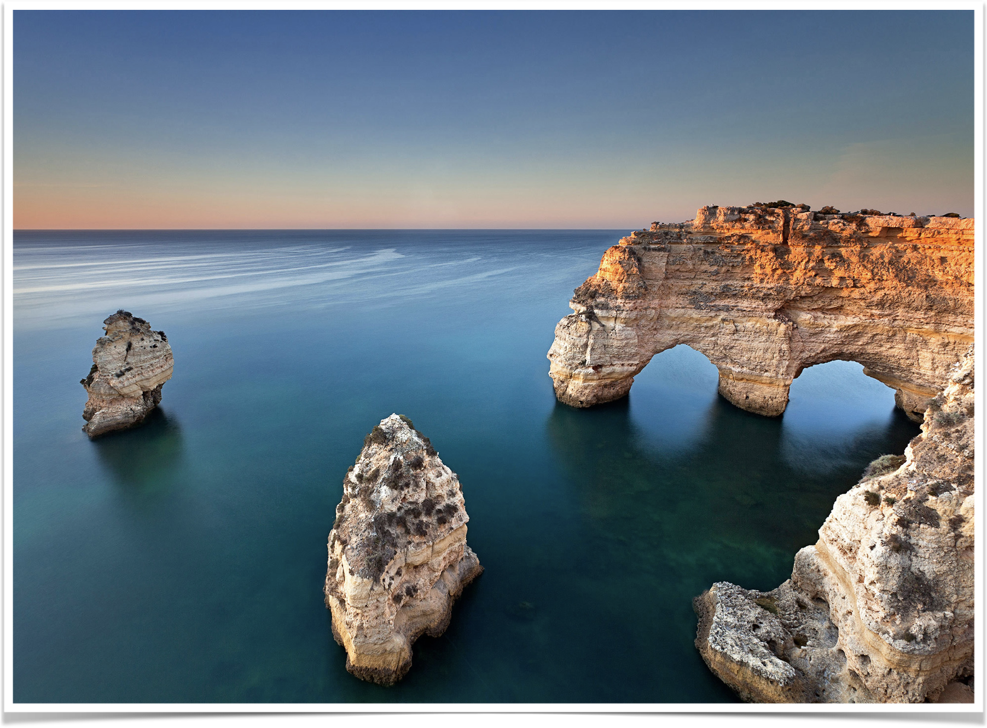
Odoacer and the fall of Rome
473 - conglomeration of tribes invade Italy
476 - city of Rome falls
493 - Italy becomes the kingdom of the Ostrogoths
Notes:
473 - Conglomeration of barbarian tribes made up of Heruli, Sciri, Rugii, and others formerly under Atilla invaded Italy.
476 - Rome falls to Odoacer
Slew emperor and placed Odoacer (or Odovacer) as the Emperor
Convened the Senate and offered sovereignty over the entire empire, minus Italy, to Zeno, Emperor of the East.
Zeno accepted the throne, and the line of Western emperors was broken.
493 - Odoacer is beaten in battle and murdered by Theodoric the Great
Italy becomes the kingdom of the Ostrogoths.
The line of kings following comes through Theodoric the Great, not Odoacer.

Slide 26
“ln 400 Alaric led the Visigoths over the Alps into Italy, and in 410 they took and sacked Rome. In 429 Gaiseric led the Vandals to the conquest of Spain and Africa, and in 455 they took and sacked Rome. In 451 Attila led the Huns in an attack upon Gaul and Italy; he was defeated at Chalons, but overran Lombardy. In 472 a Pannonian general, Orestes, made his son emperor under the name of Romulus Augustulus. Four years later the barbarian mercenaries who dominated the Roman army deposed this "little Augustus," and named their leader Odoacer king of Italy. Odoacer recognized the supremacy of the Roman emperor at Constantinople, and was accepted by him as a vassal king. The Roman Empire in the East would go on until 1453; in the West it had come to an end.”

